Slide 1
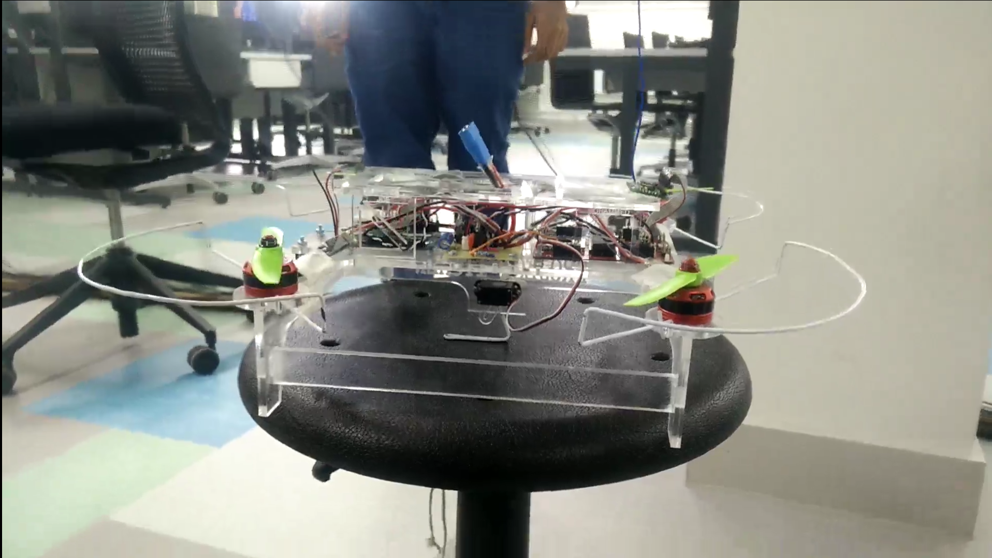
D4 - System Design Exercise Project Itchen
Team Ganges
24/03/2017

Slide 2
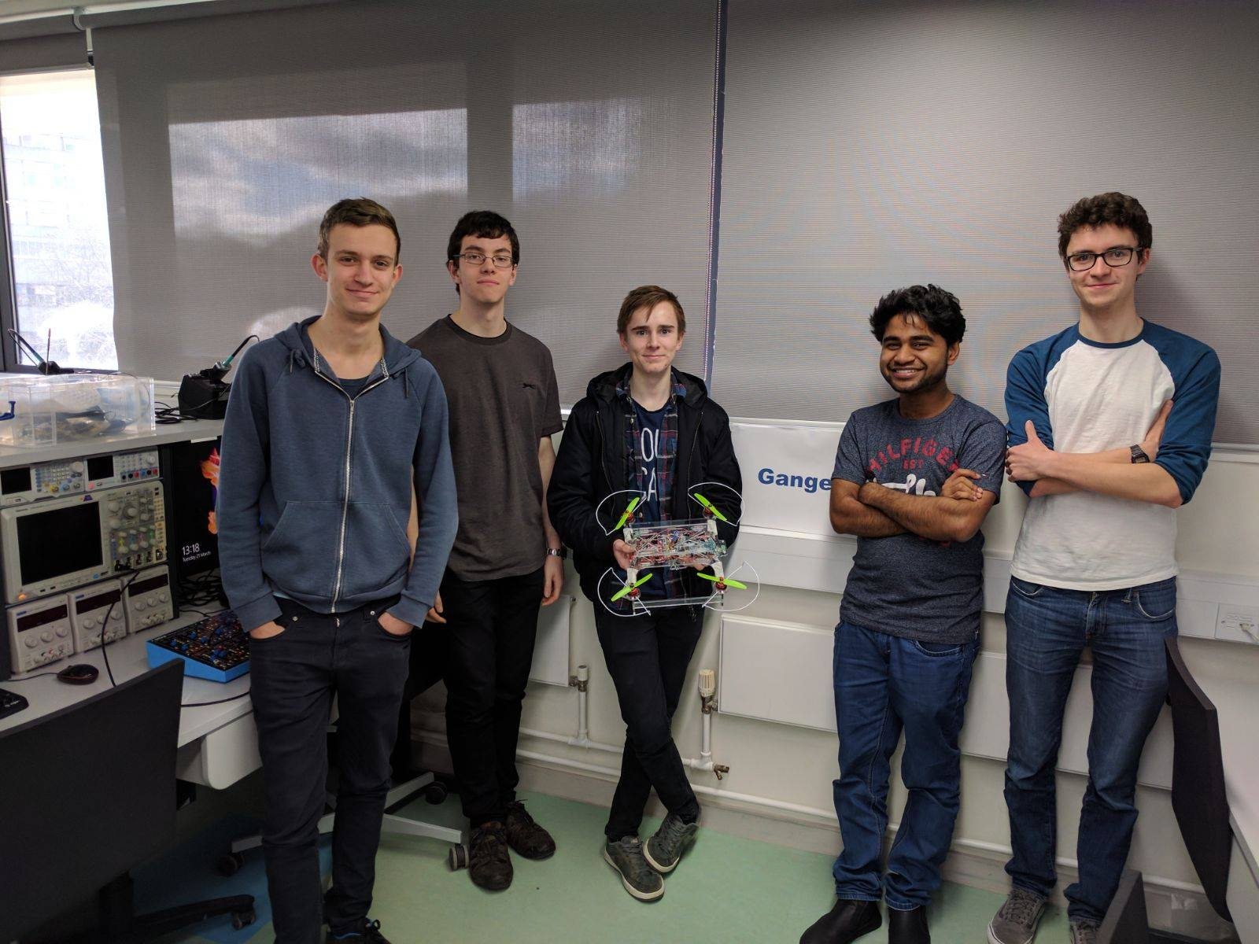
Team Ganges
Joel Trickey – Communications, Encryption
Joe Hindmarsh – Control, Extra Features
Lawrence Gray – Control, Chassis Design
Mohammed Ibrahim – Communications, UI
Ben Rowlinson – Team Leader, Integration
Notes:
INSERT TEAM PHOTO HERE!

Slide 3
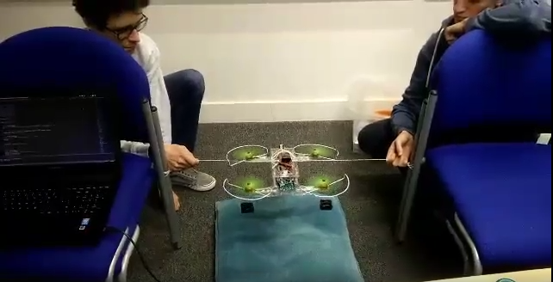
This Presentation
Outline of the Brief
Target Market Analysis
Costings
Development
Problems
Solutions and the Future

Slide 4
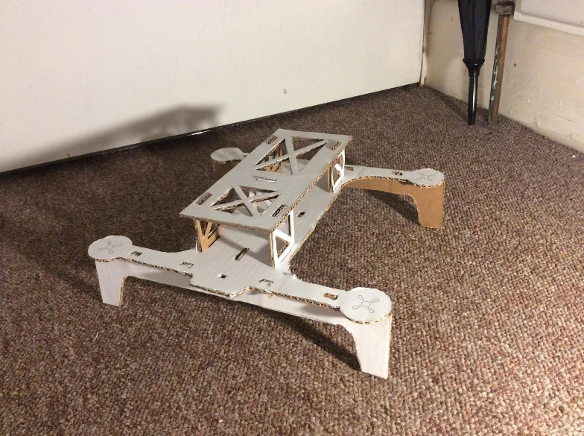
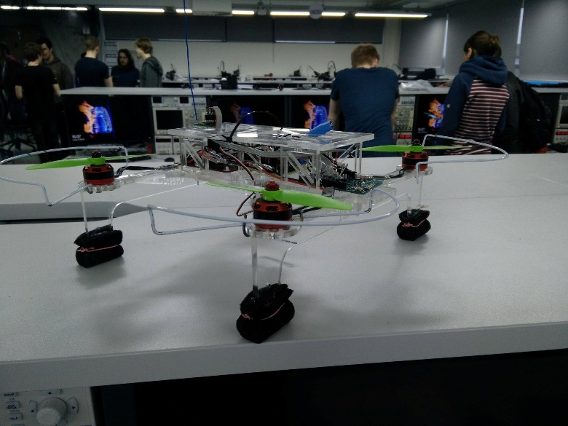
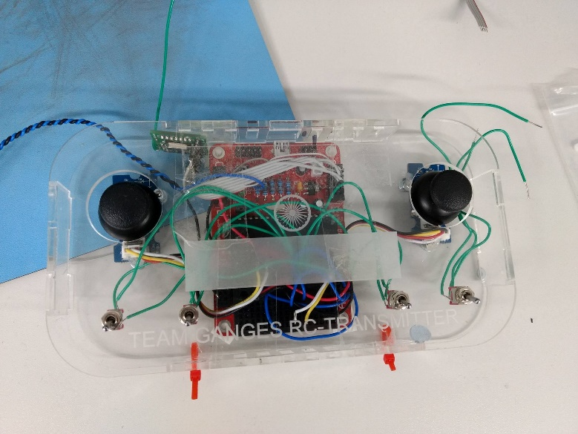
The Brief
“To design and build an unmanned aerial vehicle (UAV) that can pickup, carry and drop-off a cargo”

Slide 5
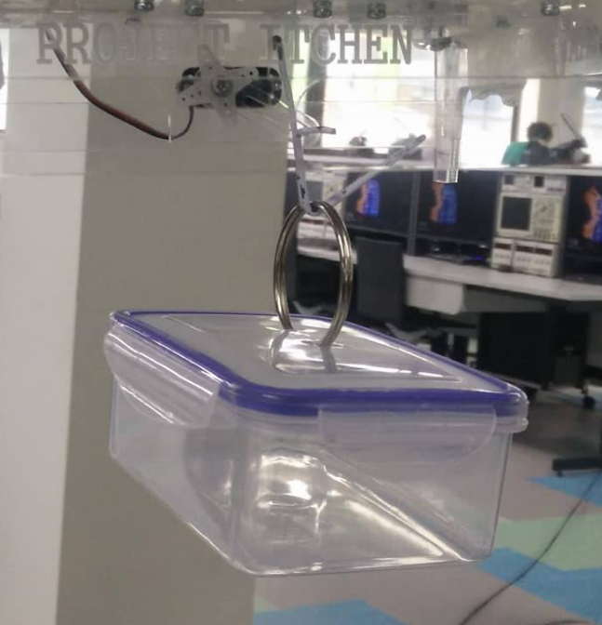
Target Market
Itchen required a solution which:
Has good cargo to UAV weight ratio
Is safe for the users
Is a low cost solution
We delivered a UAV which incorporates:
Custom User Interface
Two-Way Communications
Automated Stabilisation
Assisted Cargo Acquisition

Slide 6
Costings
Costs £160.05 for one production unit
Retail at £300 gives a profit margin of 46.7%
1228 units to be sold to breakeven (at a yield of 90%)
Expected that >2000 UAVs needed
>700 person-hours
Notes:
Expected that more UAVs needed for sustainable wide range delivery network

Slide 7
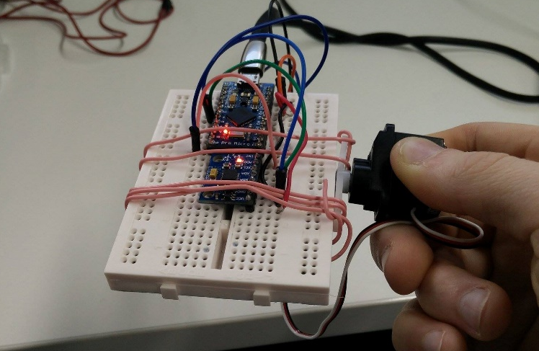
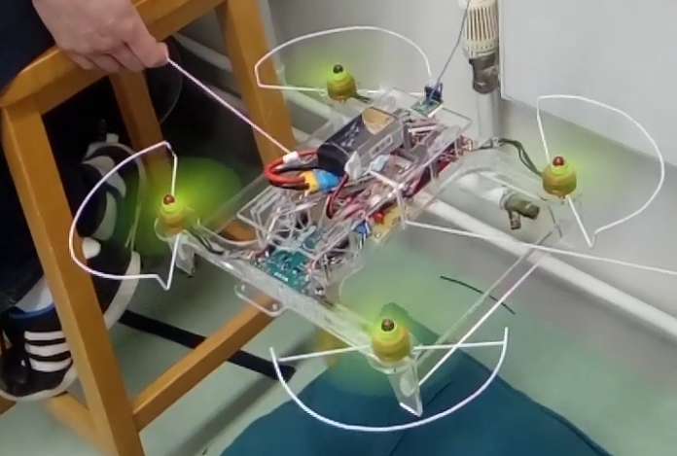
Development
Hardware Sourcing
Software Development
Chassis and Controller Manufacture
System Integration
Full system tuning/testing
Documentation

Slide 8
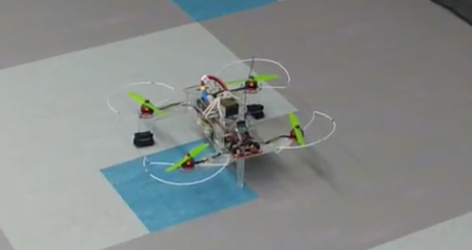
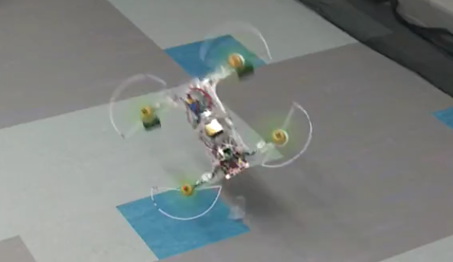
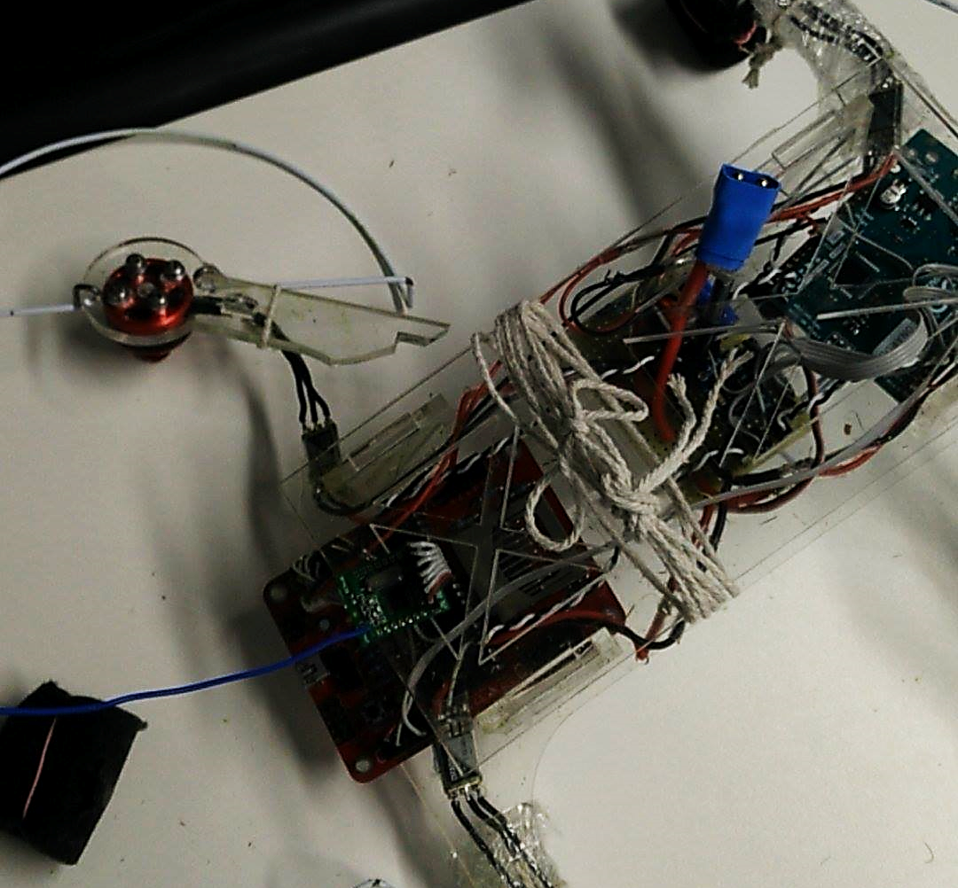
Problems
Did not achieve full stability
Heavy (>900g)
Short Battery life
Pitch back during testing
Chassis broke 9 times

Slide 9
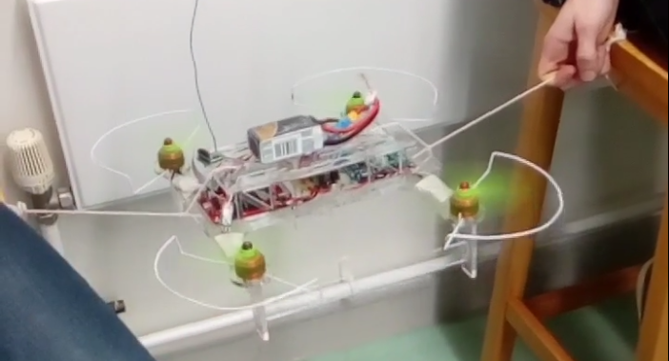
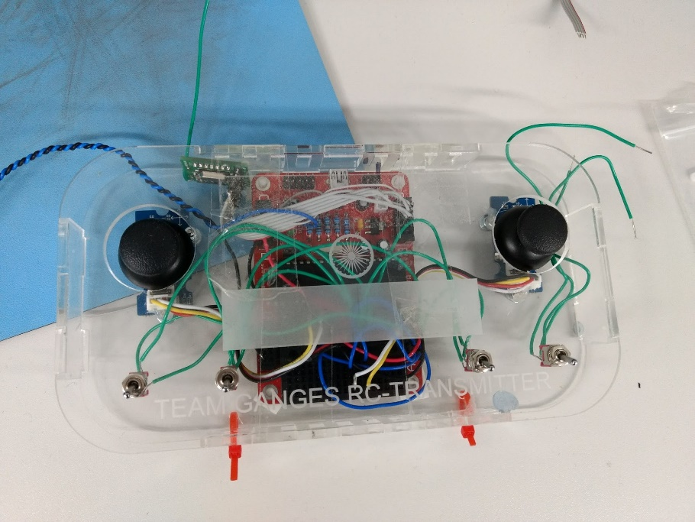
Solutions and the Future
Close to good stability
Less brittle and lighter frame
Add TFT screen to controller
Re-evaluate testing procedure
Longer battery life
Autonomy
Notes:
With a few more hours of tuning and debugging we could achieve stable flight

Slide 10
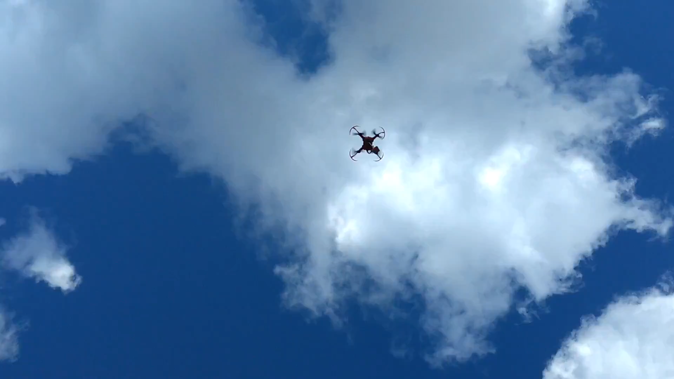
What we covered
Outline of the Brief
Target Market Analysis
Costings
Development
Problems
Solutions and the Future
Questions?
All image and content acknowledgement to Team Ganges And Jon Simmons

